Slide 1
The Pizza Proprietor
Optimizing the Pizza Startup Strategy for quick profits

Slide 2
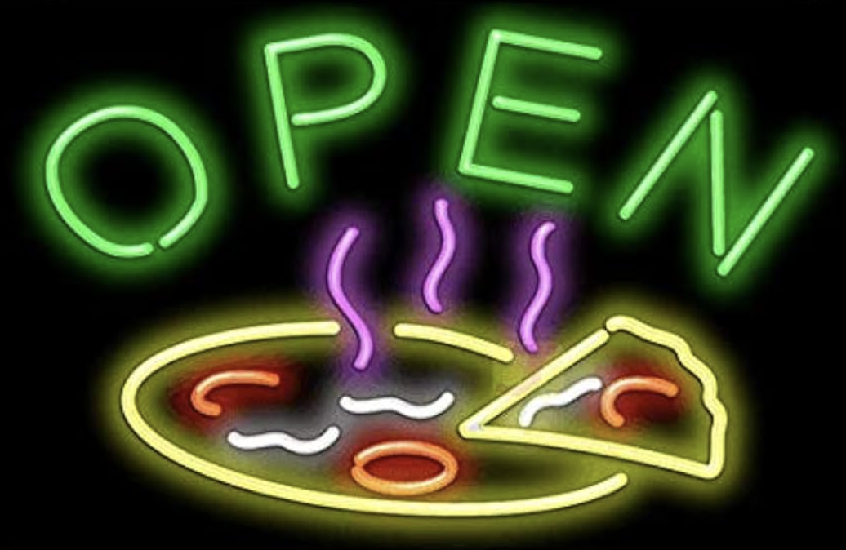
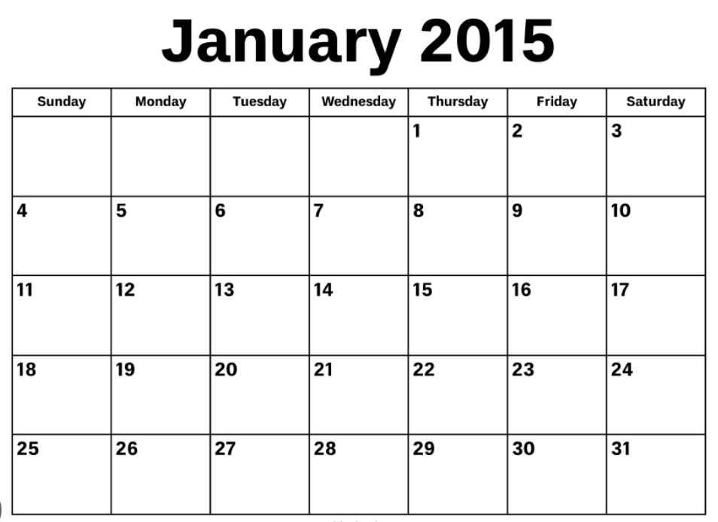
Optimizing for Timely Profitability
Main Considerations:
When is it profitable to be open? When would we operate at a loss?
How much staff and ingredients should we plan for at any time to optimize profits?

Slide 3
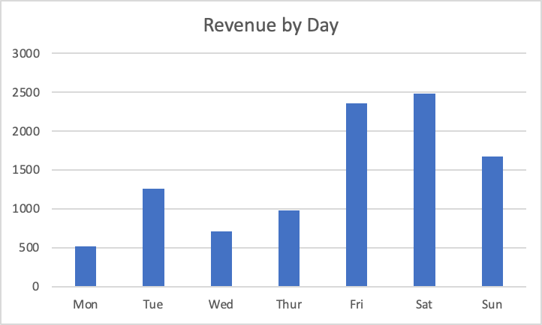
Fridays into the weekend are booming (averaging $1600-2500 per day)
Monday and Wednesday are particularly slow (averaging $500-750 per day)

Slide 4
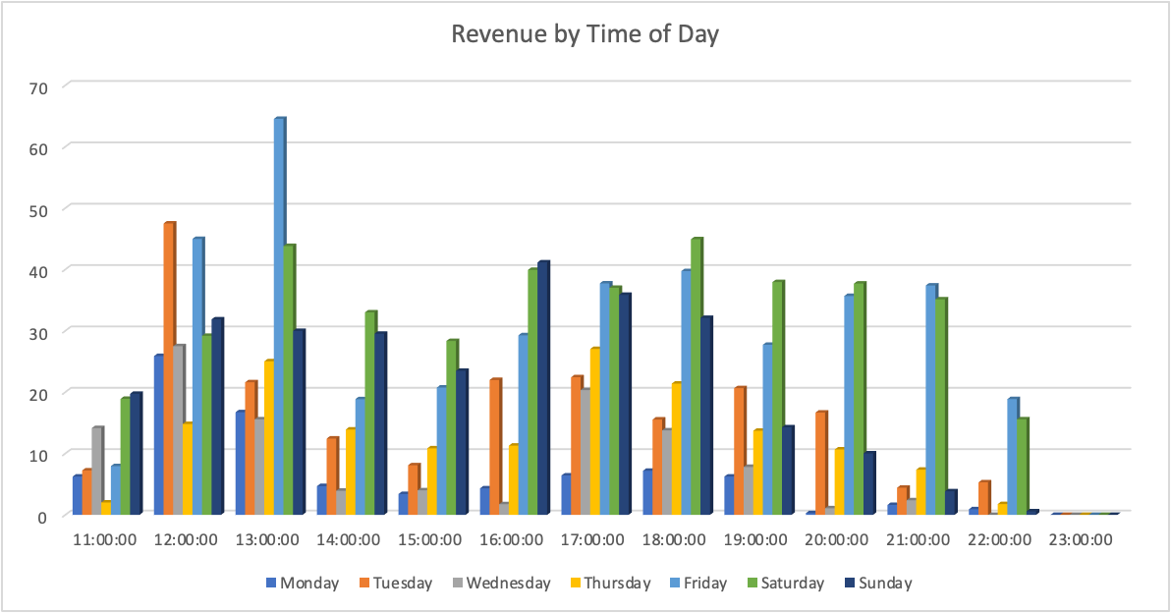
Busiest Times of Day

Slide 5
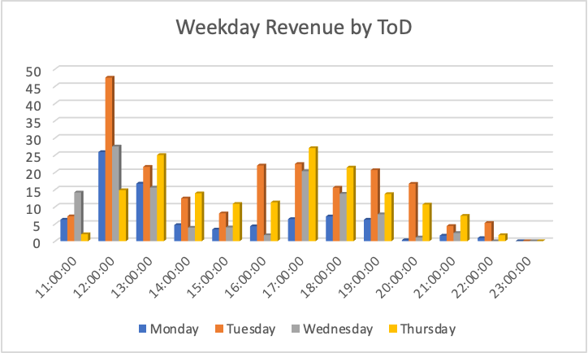
Business slows from:
11-12pm
2-4pm
9-11pm
Good profits from the lunchtime crowd and dinnertime patrons
12-1pm
4-8pm
Mondays generally remain slow, save for 12pm
Weekday Revenue per Hour

Slide 6
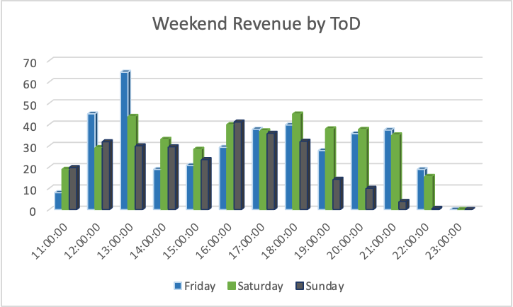
Sunday revenue drops off after 6pm
A lull on Fridays from 2pm-4pm
Revenue by Weekend Hours 11am-11pm

Slide 7
Takeaways for Timely Profitability
During unprofitable days (Monday and Wednesday) and hours (ie. between 2-4pm and Sundays after 6pm), it may be a consideration to stay closed if the revenue is at a deficit to operating costs
Focusing operation power during peak hours (lunchtime 12-1pm and dinnertime 4-8pm)
Hours and Day of the Week
(Total, Weekdays Only, Weekends Only)

Slide 8
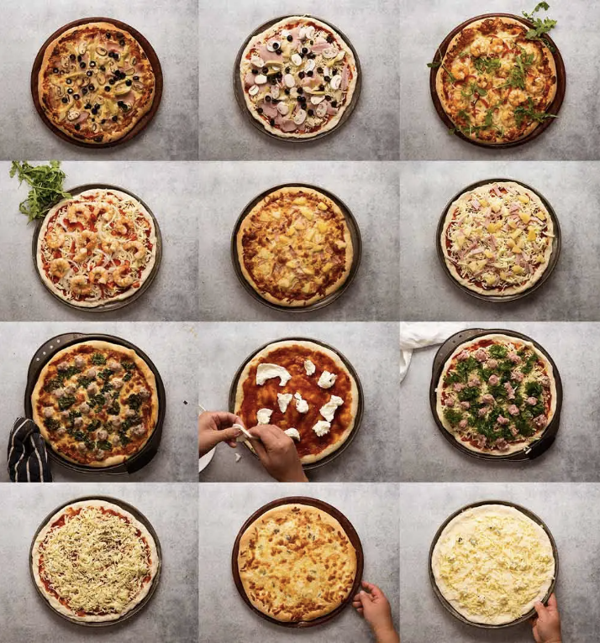
Optimizing for Toppings Selection in Revenue
Main considerations:
What items should be on the menu to achieve maximum profitability and reduce the risk of losses?
Limit choices to best-selling topping in order to streamline production and reduce food waste
Leads to reduced wait time, less required staff and cost efficiency with regards to ingredients

Slide 9
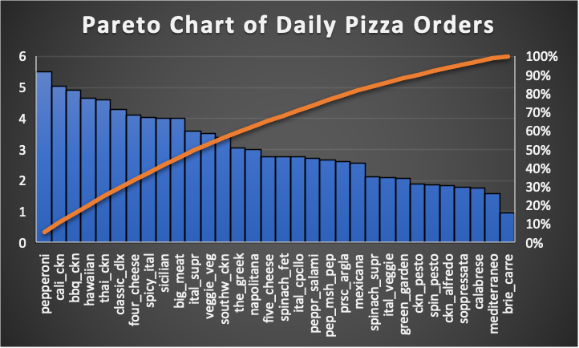
Value of Pizza Toppings to Overall Sales
Everything to the right of Spinach Supreme (spinach_supr) can be taken out to still make up 80% of total pizzas sold
The top 10 pizza types make up around 50% of total sales
10 out of 31

Slide 10
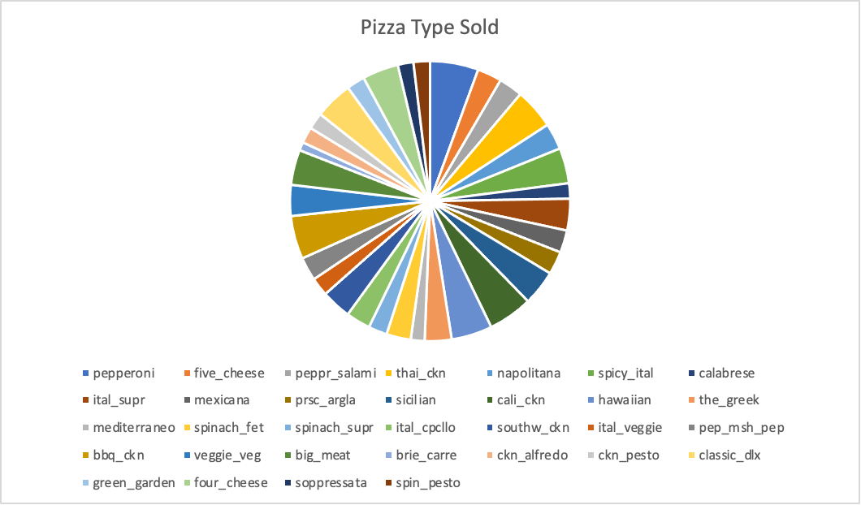

Slide 11
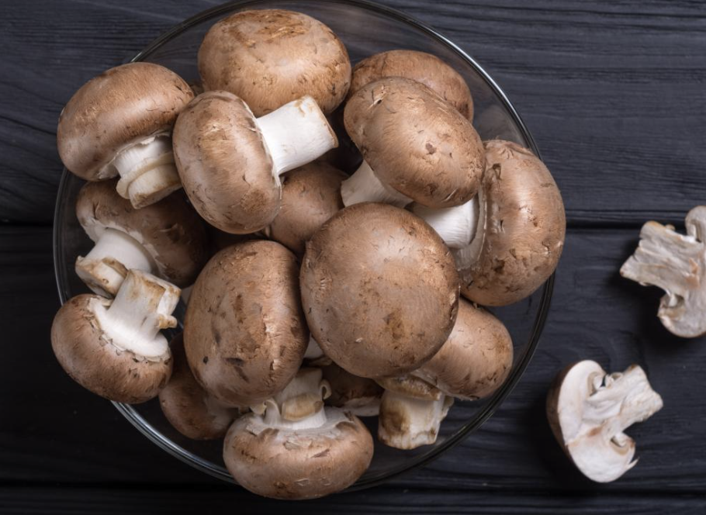
Takeaways for Pizza Choices
Two-thirds (22/31 topping options) of overall pizza topping options make up for over 80% of overall sales
Can limit the topping options to 10-20 choices
The Top 10 makes up 50% of overall sales
Most popular and least popular toppings

Slide 12
Concluding Suggestions
Timely Profitability:
Consider closing the store during off-hours (weekdays 2-4pm and 9-11pm)
Consider closing the shop at 10:30pm
Mondays are particularly slow (save for lunch)
Pizza Order Choices:
Consider limiting pizza ingredients to 20 choices
Keeping stock of the Top 10 Pizza toppings to ensure 50% of sales

